Slide 1
Meeting 4-20
Will Yuhang Li

Slide 2
Experiment Goal
Pitch -> S/D tasks & Syllable -> P/A task
Randomized non-attending dimension decrease the performance
8 subjects: 6 sd first, 2 pa first

Slide 3
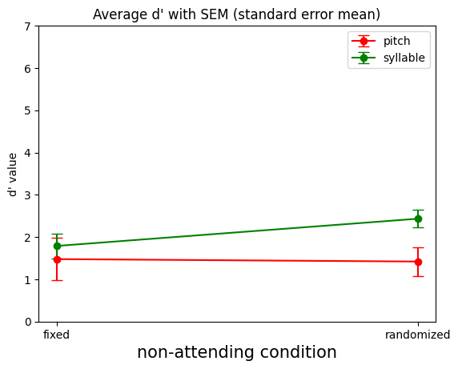
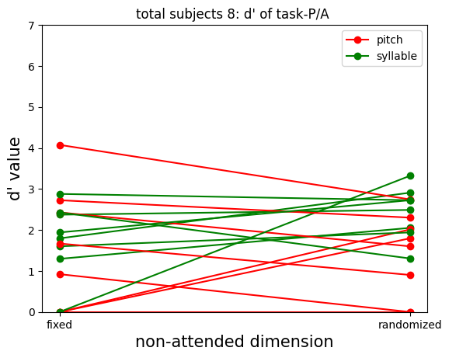
Results for P/A Tasks - 8 subjects

Slide 4
Results for P/A Tasks - 8 subjects
Pitch: ⅝ shows decrease d’
Syllable: no obvious pattern

Slide 5
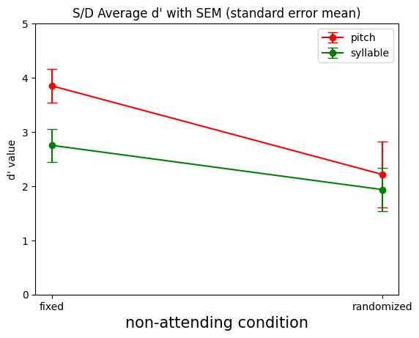
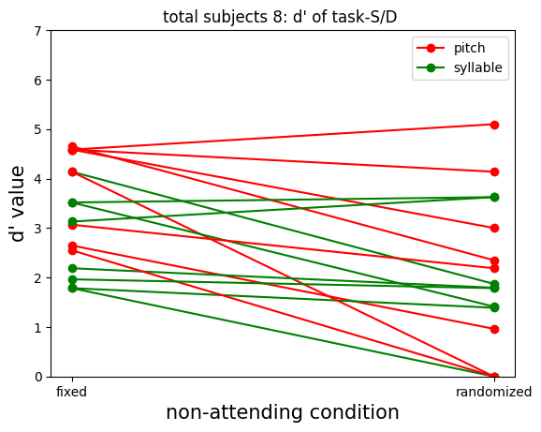
Results for S/D Tasks - 8 subjects

Slide 6
Results for S/D Tasks - 8 subjects
Pitch:
⅞ shows decrease d’
Syllable:
⅝ shows decrease d’

Slide 7
Future
Plans
Notes:
Think 6 7 8 but worry about too long

